Slide 1
Peter Kropotkin’s Contributions to Social and Economic Evolution
John Hall, Portland State University, Portland, the USA
johnbattailehall@gmail.com
Svetlana Kirdina, Russian Academy of Sciences, Moscow, Russia
kirdina777@gmail.com

Slide 2
Our Motivation
The intellectual exchange of institutional and evolutionary thought taking place between nations, like the USA and Russia, is slow and also sometimes fraught with misunderstandings stretching over decades and even centuries (two examples will be presented below).
Our task is to accelerate and refine the exchange of ideas and thereby contribute to improved understandings between Institutionalists and Evolutionary Theorists across regions and countries.

Slide 3
Thorstein B. Veblen (1857-1929)
“Why Is Economics Not an Evolutionary Science?” QJE (1898)
In Russian:
Истоки (Istoki means Beginnings) (2006)

Slide 4
Prince Peter Kropotkin (1842-1921)
Mutual Aid:
A Factor of Evolution.
London: William Heinemann (1902).
K’s main ideas were introduced between 1890 and 1896, and within a series of essays appearing in Nineteenth Century (the British monthly literary magazine) as a criticism of the "Struggle-for-Survival" manifesto (Struggle for Existence and its Bearing upon Man) by Thomas H. Huxley, 1888.
Published in 2006 in the USA. New-York: Dover Publications, Inc.

Slide 5
Daniel P. Todes
Darwin Without Malthus:
The Struggle for Existence in Russian Evolutionary Thought.
New York-Oxford: Oxford University Press, 1989.
Darwin in Russia Symposium,
the University of Pennsylvania, 1983.
Notes:
We are not the first to read and carefully consider Kropotkin’s 1902 book. But this appears as the first time to attempt to relate his ideas to Original Institutional Economics (OIE), and then to integrate his intellectual contribution into Institutional Thought.

Slide 6
Empirical and Intellectual Beginnigs of Peter Kropotkin’s “Law of Mutual Aid”

Slide 7
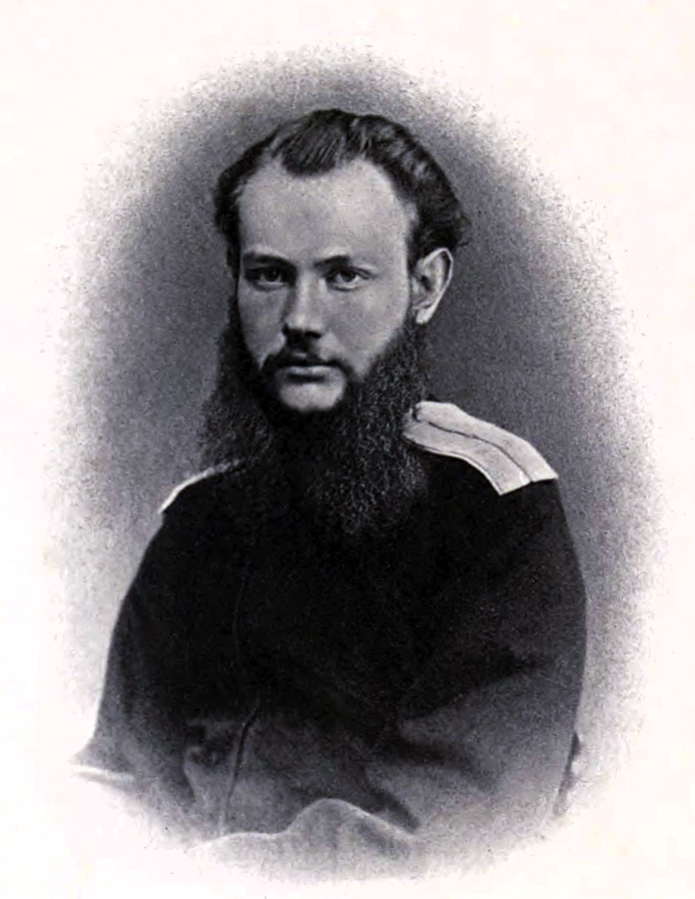
Empirical Beginnings
In 1864-65 Kropotkin initially served as aide de camp to the governor of Transbaikalia at Chita and then later he was appointed attaché for Cossack affairs to the governor-general of East Siberia at Irkutsk.

Slide 8
Geographical expeditions in Siberia
In 1864-1865 Kropotkin accepted charge of a geographical survey expedition, crossing North Manchuria from Transbaikalia to the Amur River region, and soon was attached to another expedition that proceeded up the Sungari River into the heart of Manchuria .
In 1866 K. led the Vitim Expedition from Irkutsk and along the Lena River (1500 km) to the Vitim River and then to the City of Chita.
These expeditions yielded valuable geographical results, and so much so that one of the mountain ranges in Eastern Siberia was later named as the Kropotkin Range .

Slide 9
Kropotkin after his travels to Northern Asia
“ I conceived since then serious doubts -- which subsequent study has only confirmed -- as to the reality of that fearful competition for food and life within each species, which was an article of faith with most Darwinists, and, consequently, as to the dominant part which this sort of competition was supposed to play in the evolution of new species.” (Kropotkin, 2006(1902), p. xii).

Slide 10
Kropotkin after his travel to Northern Asia cont.
“I saw Mutual Aid and Mutual Support carried on to an extent which made me suspect in it a feature of the greatest importance for the maintenance of life, the preservation of each species, and its further evolution.” (Kropotkin, 2006 (1902), p. xii).

Slide 11
Charles Darwin (1809-1882)
The Origin of Species by Means of Natural Selection.
London: John Murray (1859).

Slide 12
Intellectual Beginnings
Kropotkin absorbed the contributions of Charles Darwin and “had the theory of profound respect for Darwin's discoveries and regarded the theory of natural selection as perhaps the most brilliant scientific generalization of the century“ (Avrich, 1988, p. 58).
K. accepted that the "struggle for existence" played an important role in the evolution of species and argued that life is struggle; and in that struggle the fittest survive. However, K. rejected key ideas advanced by Thomas Huxley that placed great emphasis upon roles played by competition and conflict in the evolutionary process.

Slide 13
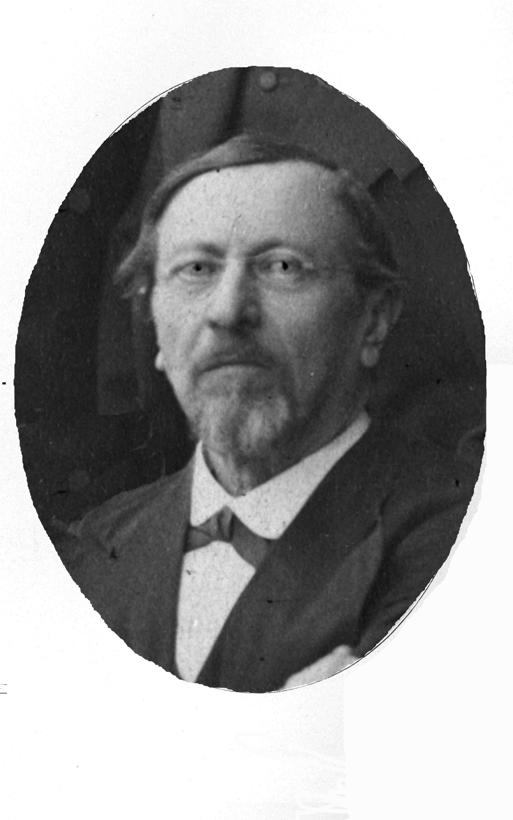
Karl Kessler (1815-1881)
He introduced
the Law of Mutual Aid
in 1880 (Memoirs (Trudy) of the St. Petersburg Society of Naturalists. Vol. xi, 1880).
The well-known Russian zoologist, the Rector of the St. Petersburg University (1867-80) in the Russian Empire.

Slide 14
Intellectual Beginnings (cont.)
In 1883, Kropotkin read and was moved by a lecture entitled “On the Law of Mutual Aid,” authored by Kessler, the distinguished Russian zoologist. In January of 1880, Karl Kessler had delivered this lecture to a Russian Congress of Naturalists. Kessler advanced ideas: that besides the law of Mutual Struggle there is in Nature the law of Mutual Aid, and what he defined as Mutual Aid proved more important, and especially for the progressive evolution of species.
Influenced by reading Kessler, Kropotkin began to collect materials for further developing the idea, which Kessler had only cursorily sketched in his lecture, but had not lived to fully develop.

Slide 15
International Intellectual Discussion
In comparison to other works of that time, for example, Les Sociétés Animales, by Espinas (Paris, 1877); La Lutte pour l'existence et l'association pour la lutte, a lecture by J.L. Lanessan (April 1881); and Louis Büchner's book, Liebe und Liebes-Leben in der Thierwelt, (second edition appearing in 1885), Kropotkin supposed that Mutual Aid would be considered, not only as an argument in favor of a pre-human origin of moral instincts, but also as a law of Nature and a factor of social evolution.

Slide 16
Mutual Aid versus Individualism
“It is a book on the law of Mutual Aid, viewed at as one of the chief factors of evolution -- not on all factors of evolution and their respective values; and this first book had to be written, before the latter could become possible.” (Kropotkin, 2006 (1902), p. xviii).
(Other factors are "individualism" and "self-assertion”, ibid.).

Slide 17
Mutual Aid versus Individualism cont.
“The struggles between < mutual aid and individualism> make, in fact, the substance of history. We may thus take the knowledge of the individual factor in human history as granted – even though there is full room for a new study of the subject on the lines just alluded to; while, on the other side, the mutual-aid factor has been hitherto totally lost sight of; it was simply denied, or even scoffed at, by the writers of the present and past generation. It was therefore necessary to show, first of all, the immense part which this factor plays in the evolution of both the animal world and human societies. Only after this has been fully recognized will it be possible to proceed to a comparison between the two factors” (Kropotkin, 2006 (1902), p. 244) .

Slide 18
Problem of Evolution from the Mutual Aid Law’s point of view
“When the Mutual Aid institutions … began, in the course of history, to lose their primitive character, to be invaded by parasitic growths, and thus to become hindrances to progress, the revolt of individuals against these institutions took always two different aspects. Part of those who rose up strove to purify the old institutions, or to work out a higher form of commonwealth, based upon the same Mutual Aid principles…. But at the very same time, another portion of the same individual rebels endeavoured to break down the protective institutions of mutual support, with no other intention but to increase their own wealth and their own powers. In this three-cornered contest, between the two classes of revolted individuals and the supporters of what existed, lies the real tragedy of history.” (Kropotkin, 2006 (1902), xix).

Slide 19
“Mutual Aid: A Factor of Evolution” - Contents
: Introduction
Chapter 1: MUTUAL AID AMONG ANIMALS
Chapter 2: MUTUAL AID AMONG ANIMALS (cont.)
Chapter 3: MUTUAL AID AMONG SAVAGES
Chapter 4: MUTUAL AID AMONG THE BARBARIANS
Chapter 5: MUTUAL AID IN THE MEDIAEVAL CITY Chapter 6: MUTUAL AID IN THE MEDIAEVAL CITY (cont.)
Chapter 7: MUTUAL AID AMONGST OURSELVES Chapter 8: MUTUAL AID AMONGST OURSELVES (cont.)
Conclusion

Slide 20
The main conclusions of Kropotkin’s investigation -1
“The animal species, in which individual struggle has been reduced to its narrowest limits, and the practice of mutual aid has attained the greatest development, are invariably the most numerous, the most prosperous, and the most open to further progress” (Kropotkin, 2006 (1902), p. 242).

Slide 21
The main conclusions of Kropotkin’s investigation -2
“…we saw a wide series of social institutions developed already in the lower savage stage, in the clan and the tribe; and we found that the earliest tribal customs and habits gave to mankind the embryo of all the institutions for mutual support and defense, which made later on the leading aspects of further progress” (Kropotkin, 2006 (1902), p. 242).

Slide 22
The main conclusions of Kropotkin’s investigation -3
“…we see also that the practice of mutual aid and its successive developments have created the very conditions of society life in which man was enabled to develop his arts, knowledge, and intelligence; and that the periods when institutions based on the mutual-aid tendency took their greatest development were also the periods of the greatest progress in arts, industry, and science” (Kropotkin, 2006 (1902), p. 244-45).

Slide 23
Another main conclusions of Kropotkin’s investigation -4
“As to the sudden industrial progress which … is usually ascribed to the triumph of individualism and competition, it certainly has a much deeper origin than that…. (Kropotkin, 2006 (1902), p. 245).
To attribute the industrial progress to the war of each against all which it has proclaimed, is to reason like the man who, knowing not the causes of rain, attributes it to the victim he has immolated before his clay idol. For industrial progress …, mutual aid and close intercourse certainly are, as they have been, much more advantageous than mutual struggle” (Kropotkin, 2006 (1902), p. 246).

Slide 24
Yet another main conclusion of Kropotkin’s investigation -5
“In the practice of mutual aid, which we can retrace to the earliest beginnings of evolution, we thus find the positive and undoubted origin of our ethical conceptions; and we can affirm that in the ethical progress of man, mutual support - not mutual struggle -- has had the leading part. In its wide extension, even at the present time, we also see the best guarantee of a still loftier evolution of our race” (Kropotkin, 2006 (1902), p. 247).

Slide 25
Why Kropotkin’s ideas were not readily accepted and integrated into our understandings of social evolution?
Supposition 1: K’s findings prove more relevant for Gemeinschaft (Community) than Gesellschaft (Society).
When K. describes social institutions, such as village communities, guilds, and more, he focuses, first of all, on willful and voluntary interpersonal relationships established between people.

Slide 26
Why Kropotkin’s ideas were not readily accepted and integrated into our understandings of social evolution?
Supposition 2: K’s anarchist orientation and his fame as the “Anarchist Prince” overshadowed his being recognized for advancing ideas related to Mutual Aid and its role in social evolution, either in his homeland of Russia, or abroad.

Slide 27
Supposition 2 (cont.)
Leading up to and also during the Soviet Era, K’s ideas challenged many of the principles underpinning centralized economy. In contrast to state centralized control, K. encouraged fully decentralized economies, based upon mutual aid and support, as well as voluntary cooperation.
Simultaneously, K. gained a reputation for his penetrating critiques of capitalism and problems associated with overblown individualism. This critical stance limited his support to defined groups in Western countries.

Slide 28
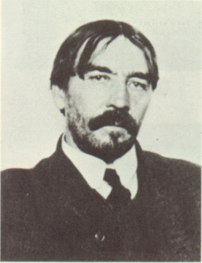
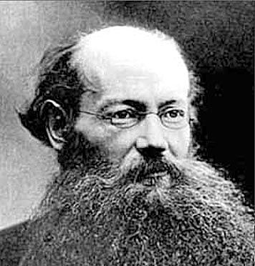
In our views, Kropotkin’s approach to evolution seems fundamentally different from Veblen’s, but curoiusly complementary.
Notes:
Their intellectual handshake failed to occur, although the two lived as contemporaries.

Slide 29
Thank you for your attention!
johnbattailehall@gmail.com
kirdina777@gmail.com

Slide 30
Postscripts: Some of Peter Kropotkin’s contributions to the world of arts and science
History (History of border service in Russian Empire)
Ethnography (papers on Siberian peoples)
Cartography (A map of the orography of East Siberia and Asia as a whole)
Geography (discovered and explored the Vitim plateau in East-Siberia)
Seismology (created a seismometer with the engineer Zotikov and tested it in 1867)
Geology (established the existence of the Ice Age in Eastern Siberia, and explored its traces); His name is immortalized at Kropotkin Ridge -- a mountain range running through Eastern Siberia to the north of Lake Baikal ….

Slide 31
Some interesting facts
George Bernard Shaw referred to Prince Kropotkin as “one of the Saints of the 19th century”
In his honor and in Year 1957, the Dvorets Sovetov (Palace of Soviets) Metro Station in Moscow got renamed as Kropotkinskaya.
Indeed, it seems a bit humorous and ironic--but also fully symbolic--that the first cooperative café in the USSR (opened during Gorbachev’s perestroika program ) sat proximate this station. This name recognition seems fully appropriate and descriptive, because Peter Kropotkin weighs in as one of the strongest supporters of cooperation in the world.

Slide 32
References.
Avrich, Paul. Anarchist Portraits. Princeton, NJ: Princeton University Press, 1988. xiii + 313 pp .
Kessler , Karl. On the Law of Mutual Aid. In: Memoirs of the St. Petersburg Society of Naturalists. Vol. xi, 1880. (O zakone vzaimopomocschi. Trudy Sankt-Peterburgskogo obshchestva estestvoispytatelei). In Russian.
Todes, Daniel P. The Struggle for Existence in Russian Evolutionary Thought. New York-Oxford: Oxford University Press, 1989. 221 pp.
Kropotkin, Peter. Mutual Aid: A Factor of Evolution. New-York: Dover Publications, Inc. , 2006 ( London: William Heinemann, 1902). 312 pp.

