Slide 1
Russian Reactions and Pointed Challenges to the ‘Struggle for Existence’ in Evolutionary Thinking
Svetlana Kirdina
Institute of Economics, Russian Academy of Sciences, Moscow, Russia
John Hall
Portland State University, Portland, Oregon, USA

Slide 2
Outline
A review of Chapter 3 “Struggle for Existence” of The Origin of Species by Charles Darwin.
Perception of Darwin’s ideas in Russia: three extreme positions.
Russian context of criticism.
Competition and struggle for existence as a main focus of criticism.
Conclusion and discussion

Slide 3
A review of Chapter 3 “Struggle for Existence” of The Origin of Species by Charles Darwin

Slide 6
Charles Darwin idea of competition in the context of British culture
“The most typical representatives of the English national character in the pursuit of science rendered competition as the central theme of their inquiry” (N. Ia. Danilevskii, Rossiia i Evropa, pp. 146-47).
In the middle of the XVII century Thomas Hobbes formulated a general political theory that emphasized the role of the state in regulating competition (bellum omnium contra omnes ) as a mechanism of social dynamics.
In the second half of the XVIII century, Adam Smith formulated the theory of free competition as a source of economic progress.
In the middle of the XIX century, Charles Darwin advanced the principle of natural selection, based on the struggle for existence, the backbone of organic and social evolution.

Slide 7
Charles Darwin and Thomas Robert Malthus
Malthus’s approach advanced in his various editions of his Principles of Population can be understood as an early contribution to social science that is essentially involves an application of the mathematical, as Malthus asserts that population increases geometrically or exponentially, while food supply increases but arithmetically.

Slide 8
Origins [1859] Chapter 3, “Struggle for Existence.” Gramercy Book, N.Y., 1979, p. 117.
… as more individuals are produced than can possibly survive, there must in every case be a struggle for existence,
… either one individual with another of the same species, or with individuals of distinct species, or with physical conditions of life.
… It is the doctrine of Malthus applied with mainfold force to the whole animal and vegetable kingdom; ….

Slide 9
Perception of Darwin’s ideas in Russia: tHREE extreme poSitions

Slide 10
Charles Darwin (1809-1882)
The Origin of Species by Means of Natural Selection.
London: John Murray (1859).

Slide 11
Darwin’s The Origin of Species in Russia
In 1861 the journal Library for Reading published an essay on The Origin of Species that was more systematic and more comprehensive than any previous study on the subject published in Russian.
In 1863 the first number of the Russian Herald published "Flowers and Insects“. The author S. A. Rachinskii, professor of botany at Moscow University—explained every major component of Darwin's theoretical structure in a language that was accessible to the general reading public. He identified The Origin of Species as "one of the most brilliant books ever to be written in the natural sciences.“
In 1864 Rachinskii produced the first Russian translation of the Origin .
“Darwinism changed not only our commonsense and scientific ideas but also our world view" (Danilevskii, Darvinizm, vol. 1, part 1, p. 7. In Russian).

Slide 12
Two extreme positions
“Russian scientific institutions did not express a uniform attitude toward Darwin's theory: while at one extreme there were institutions that completely ignored organic evolution as a scientific notion, at the other extreme were institutions that not only played a major role in the speedy diffusion of evolutionary ideas but also made Darwin's theory the point of departure in wide areas of scientific research” (Vucinich, Alexander. Darwin in Russian Thought. University of California Press: Berkeley · Los Angeles · Oxford. 1989, p.31).
Representing this second position towards Darwin’s ideas, Fedor. Dostoevsky in 1876 remarked—in The Diary of a Writer —that there was a fundamental difference between Western and Russian attitudes toward Darwin's contributions to science. In the West Darwin's theory was viewed as a "brilliant hypothesis." In Russia it quickly acquired the authority of an "axiom” (F. M. Dostoevsky, Polnoe sobranie sochinenii, vol. 11, 6th ed., p. 164. In Russian).

Slide 13
The third position – strong criticism
In Russia during the 1870s and early 1880s, Darwinism became firmly entrenched in a wide spectrum of natural and social sciences, as well as in philosophical thought.
It also became a target for relentless attacks by critics. The critics were united in a determined effort to expose the flaws in both the substance and the logic of Darwin's evolutionary theory. They shared a belief that Darwinism was an ally of positivism and materialism and that it represented an antithesis to the dominant values of Russian society.

Slide 14
Russian context of criticism

Slide 15
Values conflict
Mikhail Pogodin … concentrated on Darwin's work as a classic example of science as a distinct expression of national character. Darwin's ideas were both incorrect in substance and non-Russian in their soul (Pogodin, Mikhail. Prostaia rech' o mudrenykh veshchakh . Moscow, 1873, p. 105. In Russian).
The origin of the struggle for existence was in "the moral and political conditions of contemporary Europe“ with its capitalistic values (Mikhailovskii. Cit. by Vicinich, p. 333).

Slide 16
Western-Russian antagonism
Some authors stressed the cultural, particularly the philosophical, roots, reinforced by unconscious historical instincts as well as conscious considerations. Then there were historical conflicts and manifestations of an irreconcilable conflict between western Europe and Russia ( Danilevskii. Russia and Europe and Darwinism; Sorokin, Pitirim A. Modern Historical and Social Philosophies . New York: Dover, 1963, p. 52).

Slide 17
Competition and struggle for existence as a main focus on criticism

Slide 18
No underlying ideological biases influenced Russian criticism of Darwin’s “struggle for existence”
Representatives of different political and ideological wings were found problems in accepting the Darwin’s Malthusian reference.
Among them were:
Slavophiles (Nikolai Danilevskii)
Liberals, or Westernizers (Nikolay Chernyshevskii)
Populists (Nozhin, Mikhailovsky, and Petr Lavrov)
Anarchists (Peter Kropotkin)
Marxists

Slide 19
Recognition but with criticisms
All Russian scholars in the end of the 19th century shared a strong belief in science as the main source of social progress and humanitarian values. All acknowledged the gigantic proportions of Darwin's contributions to modern science as a body of positive knowledge and a most notable achievement in emancipating the human mind from the tyranny of prejudice and superstition.
But they also shared serious doubts about certain aspects of Darwin's theory, particularly about the applicability of the biological principles of evolution like ‘struggle for existence” to the social and cultural fabric of human development.

Slide 20
Nicolai Danilevskii, the Slavophile
In 1985 he published his Darwinism (vol.1, in 1887 vol. 2), a monumental study with one goal: a full demolition of Darwin's theory of organic evolution (he died a few days before volume had reached the public). He made his attack on Darwinism part of a general and relentless war on Western "materialism.“
In Darwinism, Danilevskii presented an elaborate critique of the major principles built into The Origin of Species . Darwinism can best be described as an elaborately structured synthesis of all anti-Darwinian arguments in circulation at the time it was written.
We would like to note that in his criticism of the substance of Darwin's theory, Danilevskii relied on standard western European works, particularly on A. J. Wigand's Der Darwinismus und die Naturforschung Newtons und Cuviers (3 vols., 1874).

Slide 21
Fyodor Tyutchev (1803-1873)
Poem by Fyodor Tyutchev [1866] and
John Dewey's translation,
“Who would grasp Russia with the mind?
For her no yardstick was created:
Her soul is of a special kind,
By faith alone appreciated.”

Slide 22
Nikolai Chernyshevskii represented a liberal wing (Zapadniki) of the Russian intelligentsia
In 1889 the journal Russian Thought published his article on the origin of the ‘struggle for existence.’ [Chernyshevskii, N. G.] Staryi Transformist. "Proiskhozhdenie teorii blagotvornosti bor'by za zhizn'." RM, 1888, no. 9, sec. 2, pp. 79–114. In Russian).
Chernyshevskii attacked the ‘struggle for existence’ as a mechanism for eliminating species not contributing to organic evolution as a progressive process. Chernyshevskii could see no connection between the struggle for existence and the growing physiological complexity of organisms, the most significant index of progress in living nature. To save evolution as the cornerstone of modern biology, it was necessary to widen the base of its study far beyond the Malthusian limits.

Slide 23
Russian populists’ views
The weakness of Darwin's theory, as Nozhin saw it, lay in its viewing the struggle for existence as the chief mechanism of evolution. Mikhailovskii had no reservations about endorsing Nozhin's claim that "Darwin did not see that the struggle for existence was not an instrument of development but only a source of pathological phenomena," and that "for this reason, Darwin's entire theory can be termed the theory of a bourgeois naturalist" (Nozhin, N. D. "Nasha nauka i uchenye." Knizhnyi vestnik, 1866, no. 7, pp. 173–78. P. 175. In Russian).
In opposition to Darwin, Nozhin formulated his own law, according to which closely related animals are united by common interests and cooperation: they are not split by a division of labor and competition. This "law" served as the pivotal point of Mikhailovskii's sociological criticism of Darwin's evolutionary theory too. (Regarding Petr Lavrov’s views, we shall introduce these later.)

Slide 24
Prince Peter Kropotkin (1842-1921)
Mutual Aid:
A Factor of Evolution.
London: William Heinemann (1902).
K’s main ideas were introduced between 1890 and 1896, and within a series of essays appearing in Nineteenth Century (the British monthly literary magazine) as a criticism of the "Struggle-for-life" manifesto (Struggle for Existence and its Bearing upon Man) by Thomas H. Huxley, 1888.
Published in 2006 in the USA. New-York: Dover Publications, Inc.

Slide 25
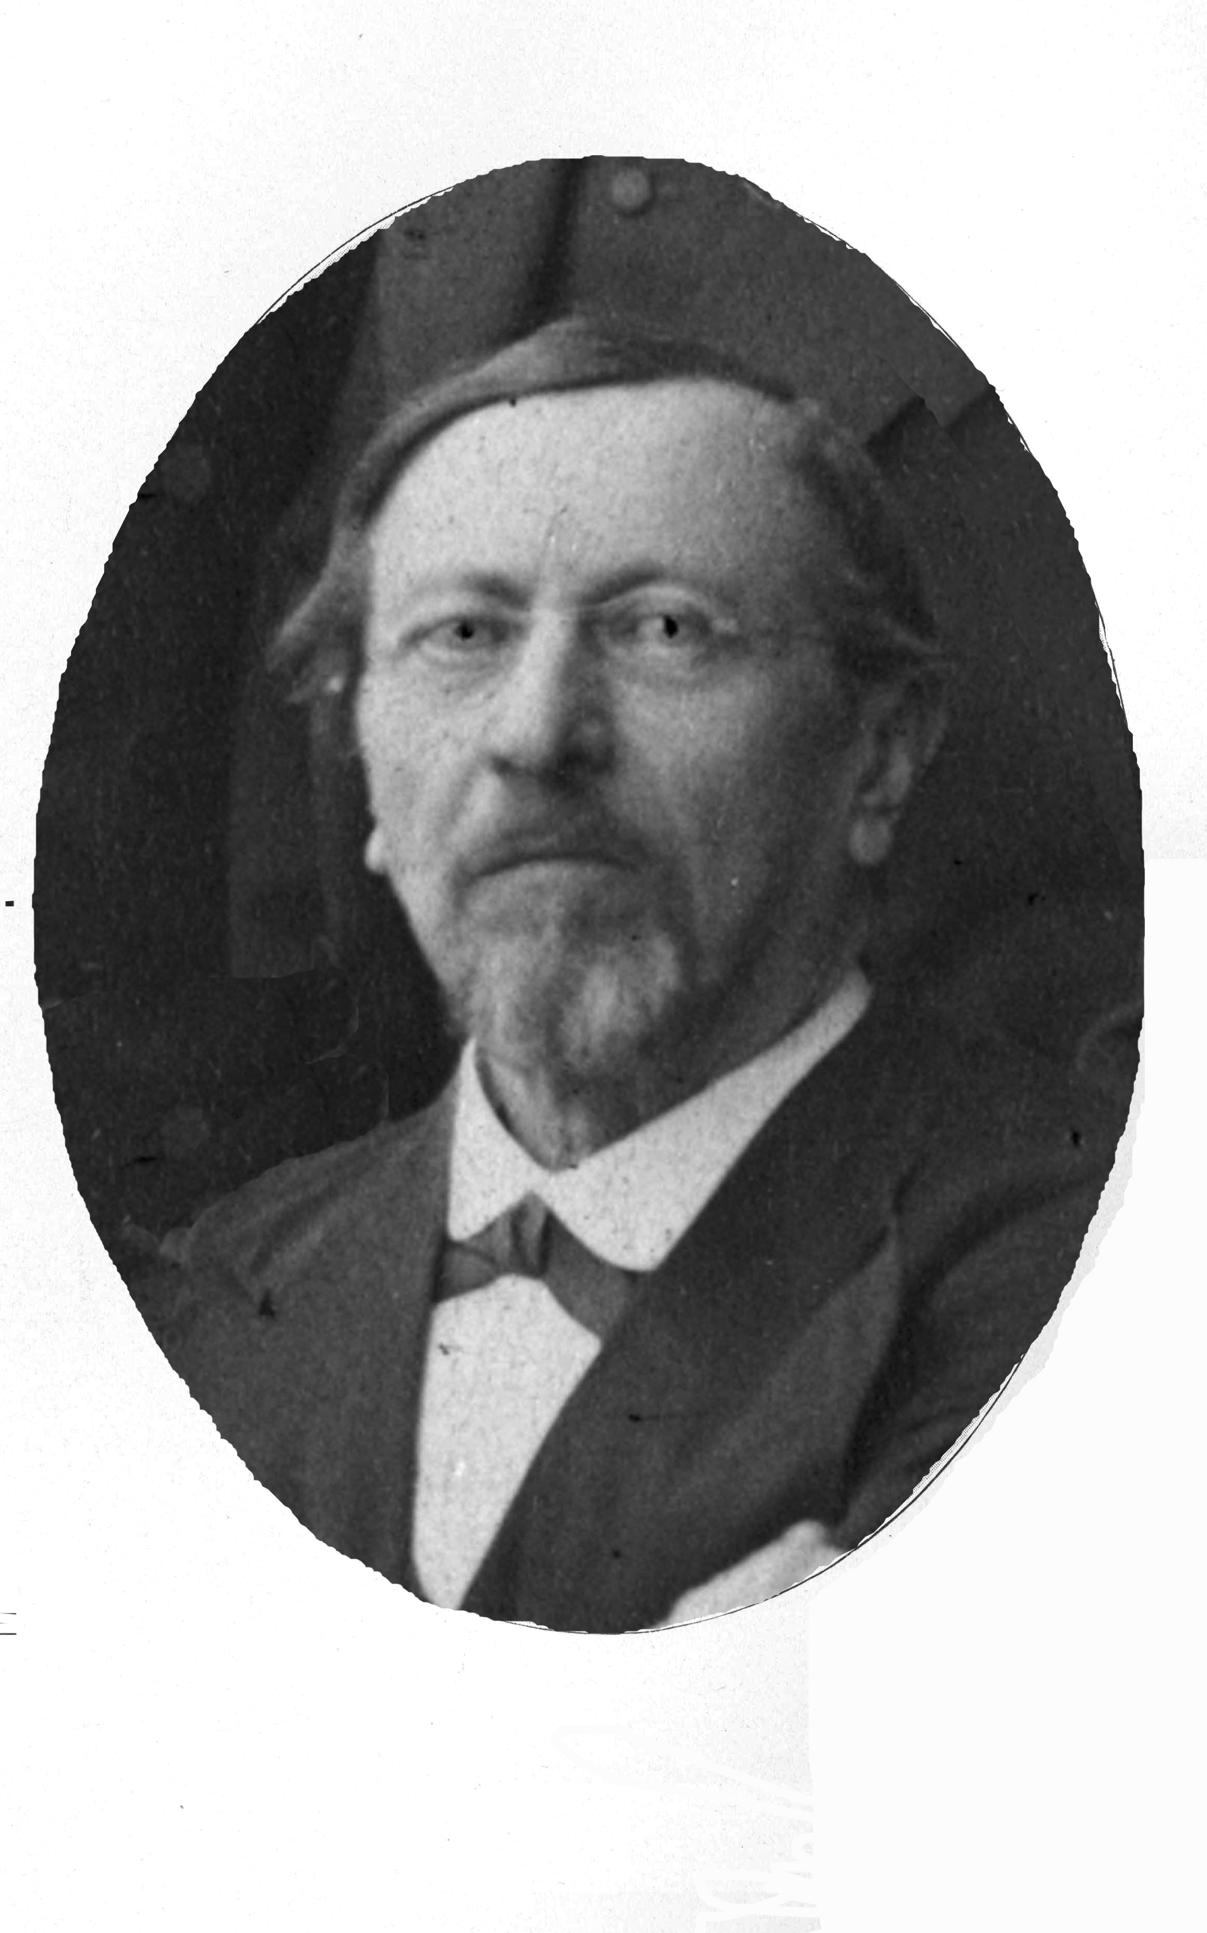
Karl Kessler (1815-1881) . The well-known zoologist, the Rector of the St. Petersburg University (1867-80) in the Russian Empire.
In line with some other natural scientists, K. criticized the emphasis on competition and the struggle for existence as a valid and universal law. K. introduced empirical findings.
K. introduced the Law of Mutual Aid in 1880.

Slide 26
International Intellectual Discussion
In comparison with other works of that time (e.g. Les Sociétés Animales, by Espinas (Paris, 1877); “La Lutte pour l'existence et l'association pour la lutte”, a lecture by J.L. Lanessan (April 1881); and Louis Büchner's book, Liebe und Liebes-Leben in der Thierwelt, with the second edition appearing in 1885), Kropotkin supposed that Mutual Aid would be considered, not only as an argument in favour of a pre-human origin of moral instincts, but also as a law of Nature and a factor of social evolution.

Slide 27
Mutual Aid versus Individualism
“It is a book on the law of Mutual Aid, viewed at as one of the chief factors of evolution -- not on all factors of evolution and their respective values; and this first book had to be written, before the latter could become possible.” (Kropotkin, 1902).
(Other factors are "individualism" and "self-assertion”).

Slide 28
Mutual Aid versus Individualism cont.
“The struggles between mutual aid and individualism make, in fact, the substance of history. We may thus take the knowledge of the individual factor in human history as granted…; while, on the other side, the mutual-aid factor has been hitherto totally lost sight of; it was simply denied, or even scoffed at, by the writers of the present and past generation. It was therefore necessary to show, first of all, the immense part which this factor plays in the evolution of both the animal world and human societies. Only after this has been fully recognized will it be possible to proceed to a comparison between the two factors” (Kropotkin, 1902).

Slide 29
Russian Marxists about Darwin theory
The defenders of Marxist orthodoxy favored Darwinism generally on ideological rather than on scientific grounds. Darwin's theory of evolution supplied Marxists with arguments that could easily be used against such archenemies of materialism as religious ethics, scriptural cosmogony, idealistic metaphysics, and subjective epistemology. It was for this reason that Marxist theorists made their admiration for Darwin strong and irrevocable.
But their attitude toward Darwin's theory qua science was of a different order: they did not keep quiet about their basic disagreement with the principles of the evolutionary theory. They rejected the very heart of Darwinian science: the Malthusian premise of the struggle for existence, the gradualism and uniformitarianism of organic change, and the transferability of the underlying principles of organic evolution to human society. It was primarily because of the pronounced ambivalence in their attitude toward Darwin that they made no serious effort to produce a comprehensive study of the Marxist view of Darwinian thought.

Slide 30
Daniel P. Todes
Darwin Without Malthus.
The Struggle for Existence in Russian Evolutionary Thought.
New York-Oxford: Oxford University Press, 1989.
Darwin in Russia Symposium,
the University of Pennsylvania, 1983.
Notes:
We are not the firsts who investigate the Darwinian ideas in Russia. But it is the first time to comprehend his ideas in the context of traditional institutional school and try to integrate his intellectual contribution into the modern institutional theory.

Slide 31
Alexander Vucinich.
Darwin in Russian Thought.
UNIVERSITY OF CALIFORNIA PRESS. Berkeley · Los Angeles · Oxford. 1989

Slide 32
Conclusion and Discussion: Mutual Aid and Cooperation
The difficult movement from biological evolution to social and economic evolution.
Ideas of :
1. Petr L. Lavrov
2. Karl Kessler
3. Petr Aleksandrovich Kropotkin
Thorstein Veblen and his Evolutionary-Institutional Economics

Slide 33
Thank you for your attention!
kirdina777@gmail.com
johnbattailehall@gmail.com

