Slide 1
Russian Economics: From Marxism to Institutional Matrices Theory
Svetlana Kirdina
Institute of Economics, Russian Academy of Sciences, Moscow, Russia
For Department of Economics,
Portland State University, the USA,
April 19, 2013, 3:00 pm
Notes:
….

Slide 2
Marxian Ideas in Russian History
Das Kapital by Karl Marx
1872 (translated into Russian)
Marxism-Leninism
~ 1890-1930s (developed by Joseph Stalin)
Political Economy of Socialism, based upon Marx
~ 1930s-1991 (up to USSR dissolution)
Turbulent Times, or Transition, or Perestroika
1990s
Marxian Ideas in Modern Russia
~ from 2000 to the present
1) Critique of modern capitalism
2) Institutional Matrices Theory, based on Marxian Economics
and Sociology, but not only

Slide 3
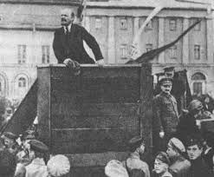
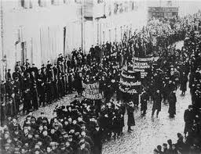
Marxism in Russia as a theoretical framework for the Revolution Project, till 1917
1872 [1867] – Russian translation of Das Kapital, Volume 1 (by Nikolai Lopatin)
1882 – Russian translation of the Communist Manifesto (by Georgi Plekhanov)
1903 – Bolsheviks (with Vladimir Lenin) split apart from the Marxist Russian Social Democratic Labor Party
1905 – 1917-Revolutionary unrest
Notes:
‘Emporer Founder

Slide 4
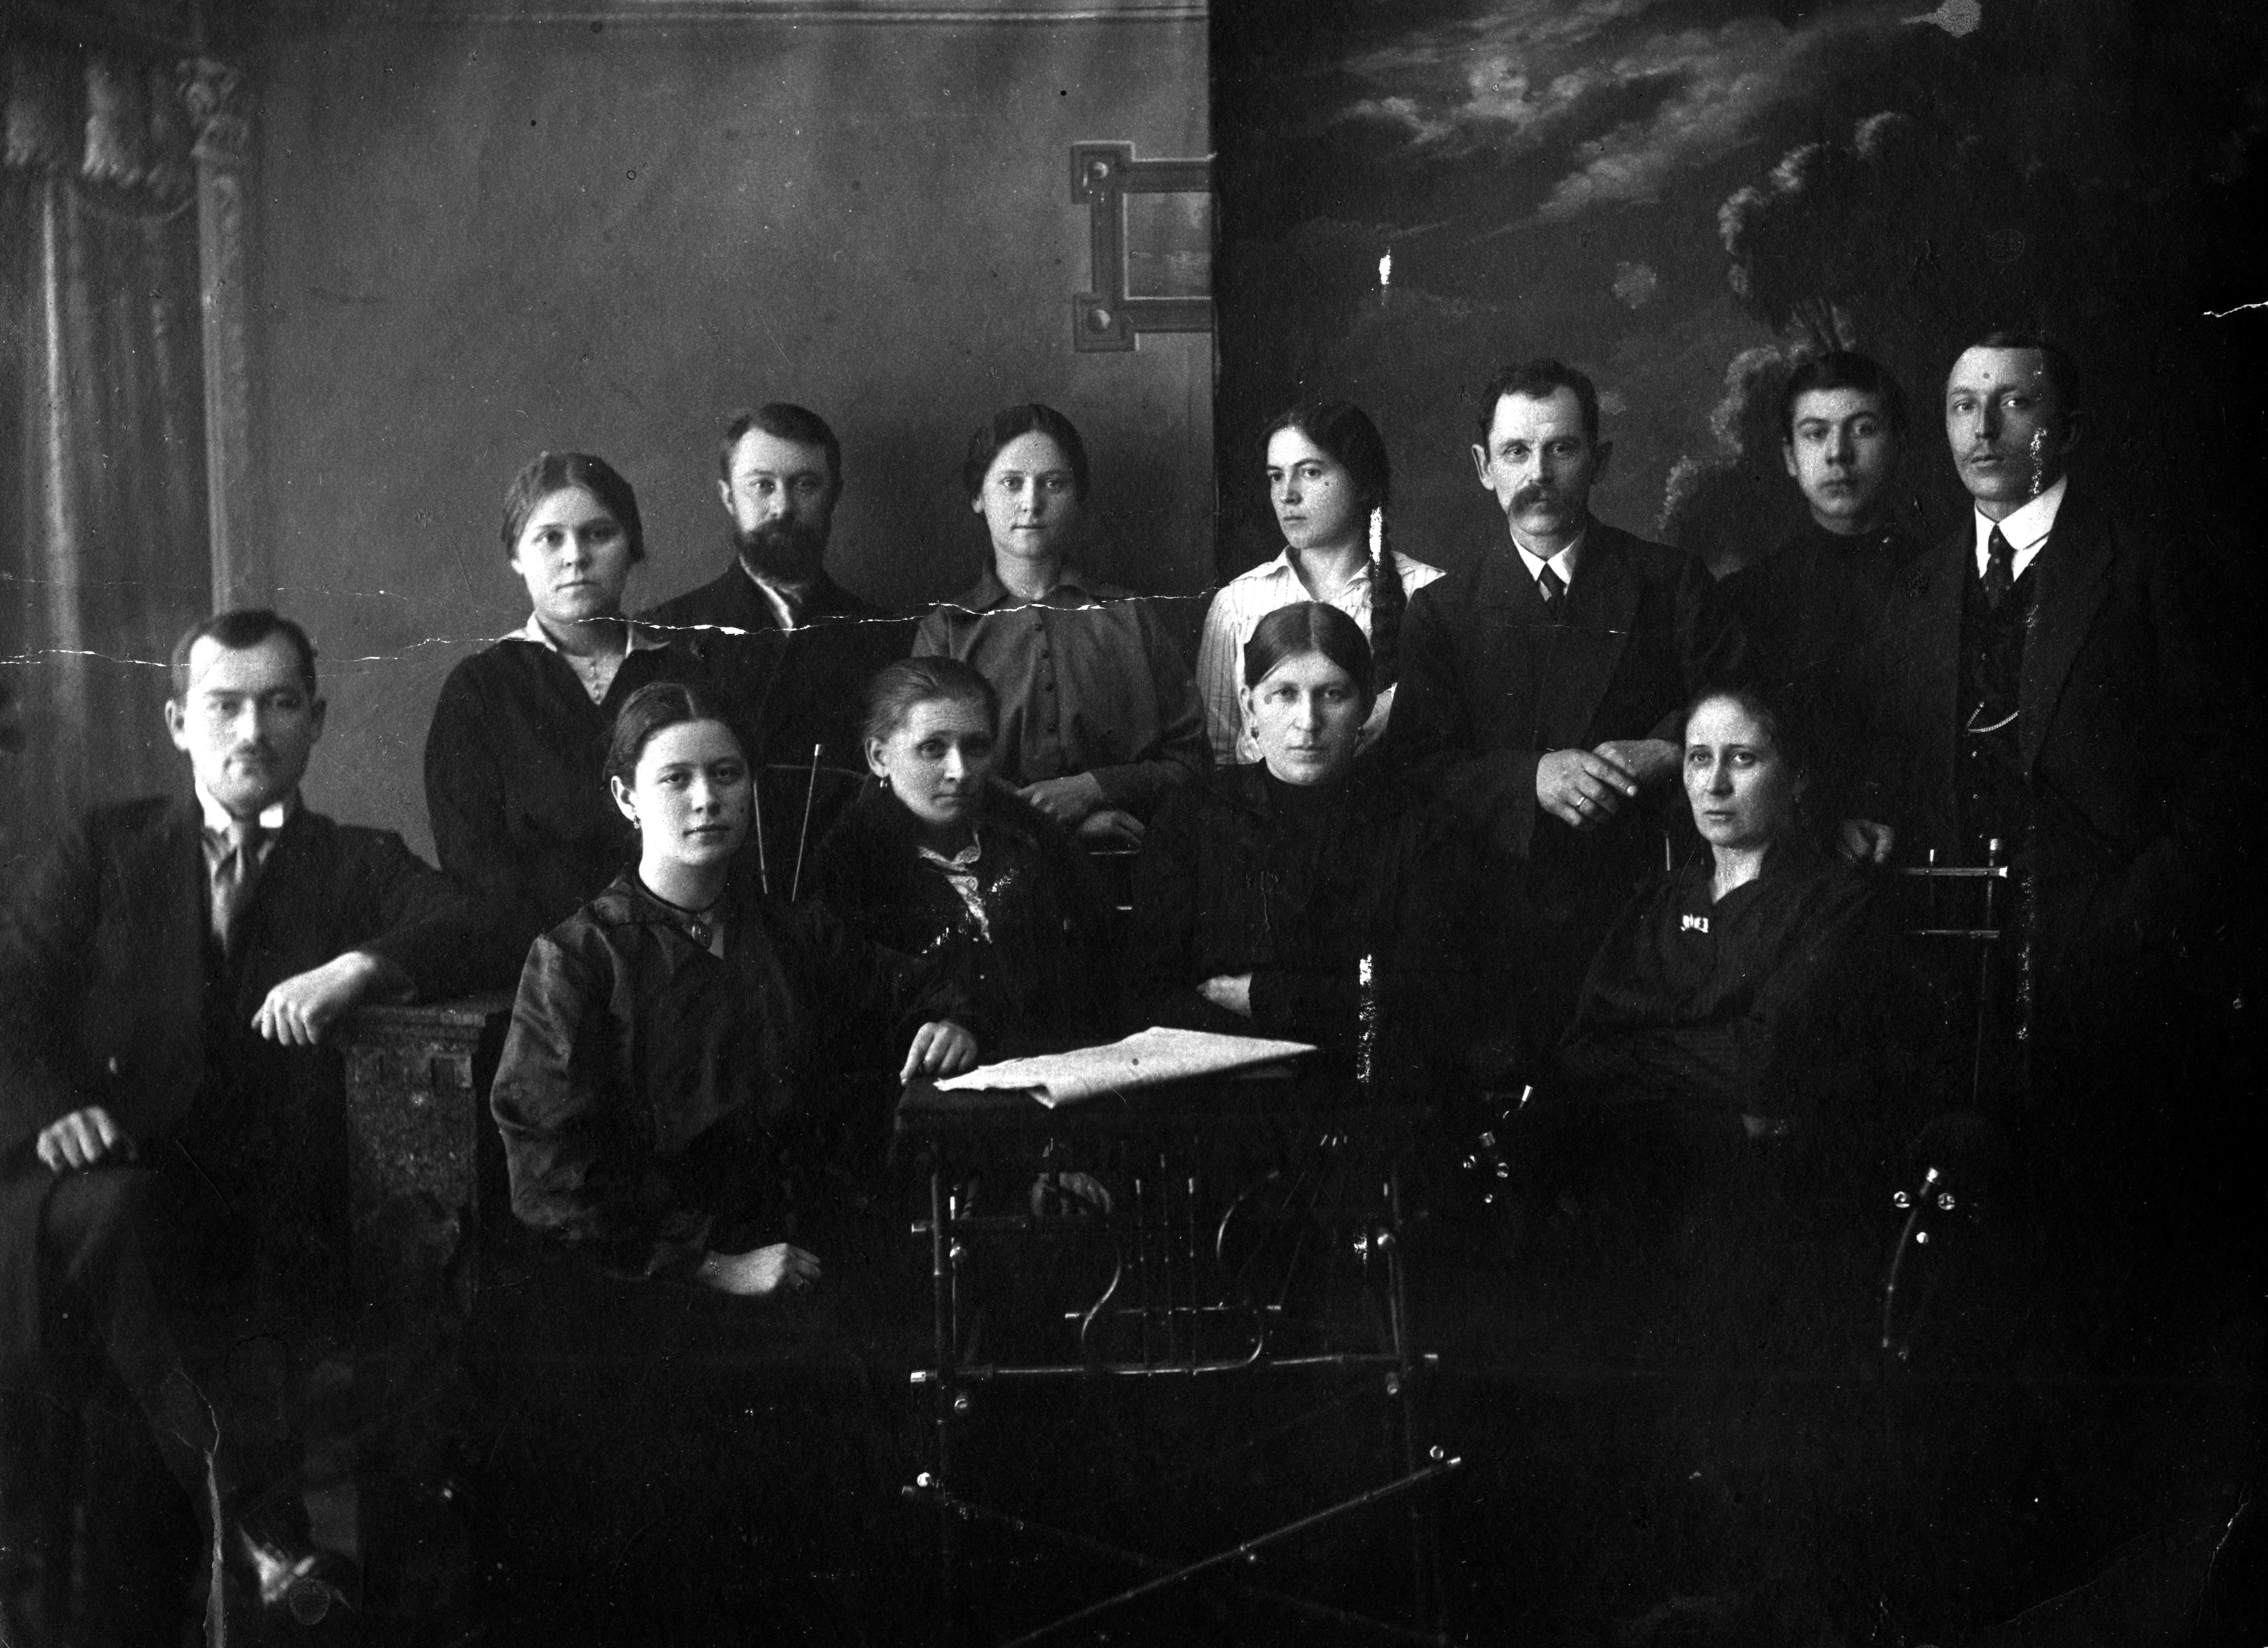
At the same time (1890th-1917) for my family
My grandmother sold dry goods (haberdasher) in her trade shop (midland Russia, Volga region).
My grandfather expanded his trade and opened some small factories.
They had 12 children - my father was the youngest one.

Slide 5
Marxism-Leninism as an official ideology after the Great October Revolution, 1917-1930s
Marxism–Leninism is a communist ideology, based upon the theories of Karl Marx, Friedrich Engels and Vladimir Lenin and based upon dialectical materialism that includes principles of class conflict, egalitarianism, rationalism, and social progress. It is anti-bourgeois, anti-capitalist , anti-conservative, anti-fascist, anti-liberal, and anti-reactionary.
The Marxist-Leninist program utilizes an economy based upon state socialism, and includes scientific planning and democratic centralism. The system supports public ownership of the means of production, and organization of the economy through the abolition of private ownership of land and capital, which becomes common property utilized by the people but through the state.
Marxism–Leninism, as a separate ideology, was compiled by Joseph Stalin in his book «Foundations of Leninism“, 1926 (English translation 1939) , and during the period of his rule in the Soviet Union it was proclaimed the official ideology of the state.

Slide 6
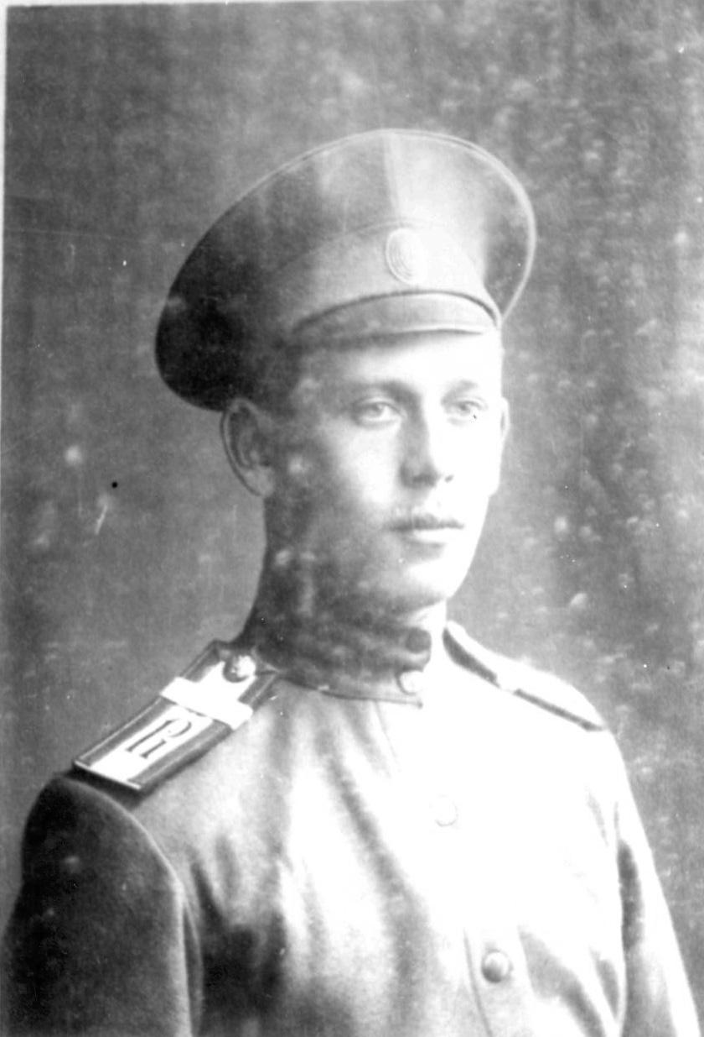
At the same time for my family, 1917-1930s
The properties of my grandparents were nationalized.
My grandmother lost two of her sons who fought on opposite sides during the Russian Civil War (1917-1922) – one for the Reds and the other the Whites. She buried one of her daughters during the epidemic of typhoid (1925).
My grandfather was exiled to Siberia.
So my grandmother took her youngest son (my father, born in 1920 ) and moved with him from to various locations in the Soviet Union where her children lived. So she avoided arrest, I suppose.

Slide 7
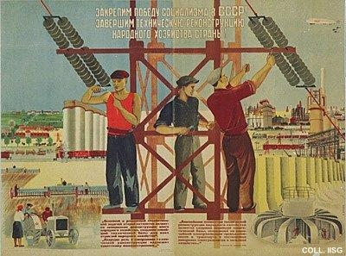
Political Economy of Socialism (~1930-1991)
During the first years that followed the October Revolution of 1917, Russian economists shared the belief that the traditional Marxian term ‘ political economy’ was to be applied to the capitalist order only. In the early 1930s, however, our economists were compelled to acknowledge the need for and thus to elaborate a political economy of socialism.
Social Ownership of the Means of Production –The Foundation of the Production Relations of Socialism:
- Socialism has two forms of social property: State property and cooperative collective farm property.
- In socialist society, State property is the property of the whole people. State property is the highest and most developed form of socialist property…
In socialist society personal property extends to the objects of consumption. A special form of personal property is the personal property of the collective farm household.
The Basic Economic Law of Socialism:
The economic laws of socialism express the relations of fraternal cooperation and socialist mutual aid of workers freed from exploitation. The Communist Party and the Socialist State base their economic policy on the economic laws of socialism.

Slide 8
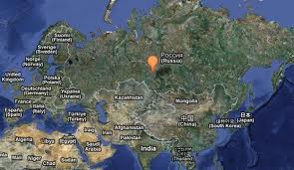
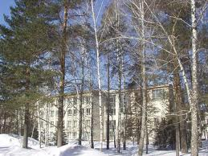
At the same time for my family, from the 1930s-1991
My father and his brothers participated in the Second World War (in Russia we called it the Great Patriotic War). They were wounded but and all of them came back alive.
My grandfather returned from exile.
I graduated from high school and then from the university in Novosibirsk (one of the top-3 in the USSR), both free. I received a degree in Economics.
I have never heard from my father about the social status of his parents and an exile of my grandfather.

Slide 9
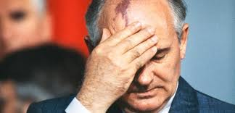
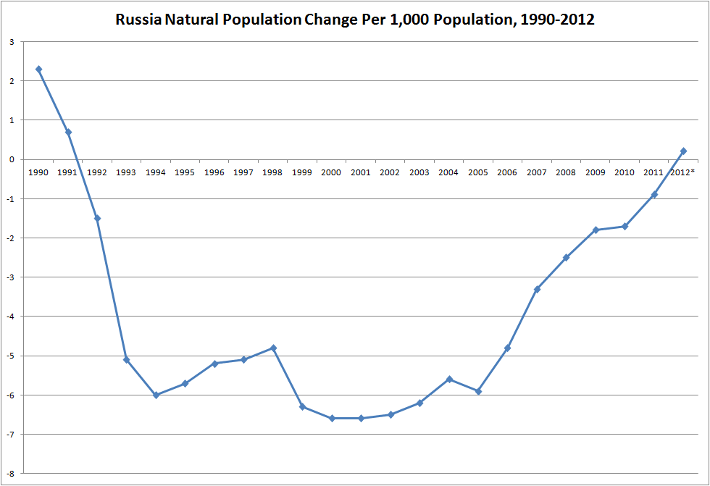
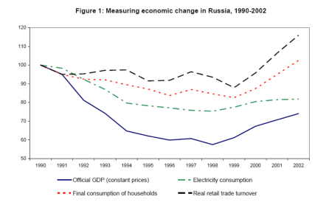
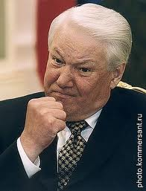
Turbulent times (Transition, Perestroika (end of 1980s), the collapse starts with the 1990s
Notes:
National emblem

Slide 10
Conditions of Marxist Research in Russia
After the fall of the Soviet Union, the official ideology of Marxism mostly disappeared.
In the 1990s, courses in Marxist Political Economy in all universities of the country were replaced by courses in Economics.
In recent years, a revival of Marxism has gradually begun.

Slide 11
Marxism and Contemporary Economic Theory in Russia
In economic scientific research in Russia, the application of Marxist ideas goes in two basic directions:
First, Marxist ideas are used to criticize modern capitalism and to show it is unacceptable for Russia (Alexander Buzgalin and Andrey Kolganov from Lomonosov Moscow State University)
Secondly, new concepts are being constructed using Marxist methods of analysis and substantive provisions are being developed on the basis of achievements in modern economic thought.

Slide 12
Main “predecessors” of the Institutional Matrices Theory (IMT), or X- & Y-theory
August Comte (1798-1857, French philosopher and social theorist) – “progress as the development of Order”
Karl Marx (1818-1883, German philosopher, sociologist, economist) - materialist conception of history
Emile Durkheim (1858-1917, French sociologist) – sociology as a science of institutions and the concept of a sui generis society
Pitirim Sorokin (1889-1968, Russian-American sociologist) – idea of social and cultural systems’ distinction
Talcott Parsons (1902-1979, American sociologist) – structural functionalism
Karl Polanyi (1886-1964, Hungarian intellectual, forced to flee to Austria, USA and Canada) – economic anthropology and redistributive economy concept
Douglass North (born 1920, USA, Economics Nobel Laureate “for having renewed research in economic history”) – coined the ‘institutional matrix’ term
Harvey Leibenstein (1922-1994, Ukrainian-born American economist ) – first to use the idea of X-efficiency
Tatiana Zaslavskaya (born 1927, Russian sociologist) – systemic analysis of social phenomena
Olga Bessonova (born 1958, Russian sociologist) – “razdatok” economic theory
Alexander Akhiezer (1929-2007, Russian culturologist) – socio-cultural evolution concept
Notes:
I mention the most prominent intellectuals whose thoughts formed the preconditions of the Institutional matrices theory. It develops the ideas of: August Comte, Karl Marx, Emile Durkheim, Pitirim Sorolin, Talcott Parsons, Karl Polanyi, Douglas North, Harvey Leibenstein, Olga Bessonova and Alexander Akhieser. Last two people are both from Russia and are not so well-known in international context. (By the way, a maternal grandfather of Polanyi was Russian, too).
What is the essence of this theory?

Slide 13
HUMAN SOCIETY… …is seen as a social system, as multiple inter-related social systems, within the main “sociological co-ordinates” being economy, politics and ideology. These value spheres are strongly interrelated morphologically as parts or sides or components of one complete whole.
Politics
Politics
Ideology
Economy
Notes:
Here is a scheme of our modeling what a society is. Society is seen as a social system within three “sociological co-ordinates ” being economy, politics and ideology. In this model:
economic interrelations related to resources used for the reproduction of social entities;
political sphere with regular and organized social actions to achieve the defined objectives; and
ideological sub-system embodying important social ideas and values.
These spheres are strongly interrelated morphologically as parts or sides of one whole. You can’t change or reform only one sphere successfully.
You can see that it is very simple and pure model – neither culture no social institutions like religion or family or education are here. It is an imperative point for constructing theoretical model which could be used for correct comparative studies of different countries – from Europe and USA to China and Brazil.

Slide 14
Main Theses of IMT, or X- and Y-Theory
Paul Klee – Eros (1923)
Each sphere (economy, politics and ideology) is regulated or guided by a corresponding set of basic institutions made-in-a-society’s image.
Economic, political and ideological institutions comprise the “institutional matrix” of human societies.
Two types of institutional matrices can be identified: the X-matrix and the Y-matrix.
Notes:
You see the main theses of the theory here.
First, each sphere like economy, politics and ideology in regulated or guided by a corresponding set of basic institutions made-in-a society’s image .
Second, economic, political and ideological institutions comprise the “institutional matrix” of human society.
Third, Historical observations and empirical research as well as mathematical modelling and a broad philosophical approach provide a ground for our hypothesis about two particular types of institutional matrices can be identified. Namely, we call the two types X-matrices and Y-matrices and compare the unique identities of each one. .An X-matrix and an Y-matrix differ by sets of institutions forming them.

Slide 15
X- and Y-matrices
Redistributive economy
X
Y
Federative political order
Individualistic ideology
Unitary-centralized political order
Communitarian ideology
Market economy
* Redistributive economy with the Center * Market (exchange) mediating economic transactions economy
* Centralized political order * Federative political order (top-down model) (bottom-up model)
* Communitarian ideology * Individualistic ideology (We over Me) (I over We)
Notes:
So, the X-matrix (on the left side) is formed by the following basic institutions:
in the economic sphere these are redistributive economy institutions (Karl Polanyi introduced this term). Redistribution means that the Center mediates and regulates the overall movement of goods and services, as well as the rights for their production and use (this is different from ‘Central Planning’ of old Soviet system, but in some ways similar); in the political sphere institutions are of unitary-centralized political order; in the ideological sphere a communitarian ideology dominates. It is expressed in the idea of priority of collective, public values over individual ones. We is over Me.
On the right side, different basic institutions are connected with the Y-matrix structure:
in the economic sphere these are institutions of a market economy (often neo-liberally regulated); in the political sphere they correspond to institutions of federative political order (where power is held outside of the Center); and the individualistic ideology dominates. It proclaims a subsidiary, subordinated character of collective values to individual ones. In this case Me or I is over We. ( like a YOYO-society
In language that is familiar in the United States, one can say that the X-matrix looks like a WITT-society ("We're In This Together”) and the Y-matrix looks like a YOYO- society (“You’re On Your Own”). Let me remind you, however, that these are ideal types that are never realised in their pure form; there is always a combination of both matrices in each society or nation.
There are sets of institutions in the economic, political and ideological spheres for each matrix. We won’t consider these institutions in details due to shortage of time. Therefore I skip the next three slides.

Slide 16
X- and Y-institutions in the economy and their functions
Functions of institutions | X-institutions | Y-institutions
1. Fixing of goods (property rights system) | Supreme conditional ownership | Private ownership
2. Transfer of goods | Redistribution (accumulation-coordination-distribution) | Exchange (buying-selling)
3. Interactions between economic agents | Cooperation | Competition
4. Labor system | Employed (unlimited term) labor | Contract (short and medium term) labor
5. Feed-back signals (effectiveness indexes) | Cost limitation (Х-efficiency) | Profit maximization (Y-efficiency)
Notes:
Structures and functions of basic institutions in X- and Y-matrices are briefly presented on the next three slides. There is a bunch or set of institutions in economic, political and ideological spheres for each matrices,. We won’t consider these institutions in details because no time.
First, I present you economic X- and Y-institutions and their functions. We can see them on the table.
First function of economic structure is to support property rights system for fixing of goods. For Y-economies, or market economies the private property is such basic institution. In {-economies a supreme conditional ownership has been forming. The supreme level of hierarchy defines conditions of possession and using of property objects - land, buildings etc. Russian or Indian rural community or village community are examples for such form of ownership. Second function is transfer of goods. In Y-economies we have the institution of exchange (or buying-selling). In X-economies the redistribution or accumulation from the bottom to the center than a coordination on the top center level and distribution to lower underlying levels. Third, institutions of interactions between economic agents are – cooperation in X-economy model and competition in Y-economy market model. Forth function is labor system organizing. There is employed ( unlimited term) labor institution in X-economy. You know that a lifetime employment system in Japan is an example. In Y-economy we have (or they have) contract (short and medium term) labor. At last, there are feed-back institutions. Well-known profit maximization (or Y-efficiency) institution acts in market economy model and cost limitation (or X-efficiency) institutions acts in X-economic model. Harvey Leibenstein is the author of the X-efficiency theory.

Slide 17
X- and Y-institutions in politics and their functions
Functions of institutions | X-institutions | Y-institutions
1.Territorial administrative organization of the state | Administrative division (unitarity) | Federative structure (federation)
2. Governance system (flow of decision making) | Vertical hierarchical authority with Centre on the top | Self-government and subsidiarity
3.Type of interaction in the order of decision making | General assembly and unanimity | Multi-party system and democratic majority
4. Filling of governing positions | Appointment | Election
5. Feed-back mechanism | Appeals to higher levels of hierarchical authority | Law suits
Notes:
Here you can compare X- and Y-political institutions. X-political order represents a top-down model of society. Therefore, Y-political order characterizes bottom-up model. I give you only the list of institutions. We have not enough time to explain them. Let us enumerate X- and Y-institutions:
First, for Territorial administrative organization of the state there are Administrative division(unitarity) in X-matrix and Federative structure federation) - in Y-one.
As for Governance system, or flow of decision making, in X-model we have Vertical hierarchical authority with Center on the top and Self-government and subsidiarity in Y-model.
Third: What is type of interaction in the order of decision making? General assembly and unanimity for X-model and Multi-party system and democratic majority for Y-one.
Fourth, Filling of governing positions can be carried out on Appointment or Election basis, respectively.
And at last we can indicate very important institution for the permanent process of institutional circle, namely Feed-back mechanism. It could be Appeals to higher levels of hierarchical authority for X-matrix or Law suits for Y-matrix.

Slide 18
X- and Y-institutions in ideology and their functions
Functions of institutions | X-institutions of communitarian ideology | Y-institutions of subsidiary ideology
1. Driver of social actions | Collectivism | Individualism
2. Normative understanding of social structure | Egalitarianism | Stratification
3. Prevailing social values | Order | Freedom
4. Labor attitudes | Money-oriented | Well-being-oriented
5. Principles of social and academic priority & relations | Generalization-Integralism/Holism | Specialization-Atomization/Mereism
Functions of institutions | X-institutions of communitarian ideology | Y-institutions of subsidiary ideology
1. Driver of social actions | Collectivism | Individualism
2. Normative understanding of social structure | Egalitarianism | Stratification
3. Prevailing social values | Order | Freedom
4. Labor attitudes | Well-being | Money
5. Principles of social and academic priority & relations | Generalization-Integralism/Holism
Notes:
Here is the list of ideological institutions. We enumerate them only. X-institutions of communitarian ideology are:
First, Collectivism as a common Driver for social actions, second, Egalitarianism as Normative understanding of social structure and An order as Prevailing social values (castes in India are an example). Respectively, a complex of Y-institutions of subsidiary ideology includes Individualism, Stratification and Freedom as Prevailing social values/
Ideological institutions expresses a social consensus on main rules and norms of social actions and indicate what is fair and just in mass opinion .

Slide 19
Combinations of governing and complementary institutional matrices
Y
Y
X
X
Russia, China, India, the USA, Canada and
most Asian, Middle Eastern, most of European
Latin American, and countries
some other countries
Notes:
Main hypothesis is that the institutional structure of each society can be presented as a combination of these two basic institutional matrices. In some societies the X-matrix institutions are prevailing, while the Y-institutions help them. We assume that it is true for Russia, China and most Asian, Latin American, and some other countries and maybe India.
At the same time in other societies the Y-matrix institutions are predominating, whereas the X-matrix institutions are complementary and additional, as, for example, in most countries of Europe and the USA.
We suppose that the main task of social and economic policy in each country is to support the optimal combination of predominant and complementary institutions. For example, the economic policy has to find the best proportion between market and redistributive institutions as well as forms of their modernization.

Slide 20
Why X- or Y-matrix Institutions?
The material and technological environment is a key determinant for either X- or Y-dominant matrices.
The environment can be a communal, indivisible system, where removing some elements can lead to disintegration of the whole system, OR
The environment can be non-communal, that is, with possibilities of technological division, with a multiplicity of labour formations and ‘network’ allegiances, along with scientific, social and/or cultural diversity.
In a communal environment X-matrix institutions are dominant and Y-matrix institutions are complementary. In a non-communal environment the situation is vice versa.
Notes:
There is an explanation why X- or Y-matrix institutions dominate in different countries. Our hypothesis is that the material and technological environment is the key facor. The environment can be a communal indivisible system, where removal of some elements can lead to disintegration of the whole system, - or it can be non-communal with possibilities of its technological division. In a communal environment the institutions of X-matrix are dominant whereas Y-matrix institutions are complementary. In a non-communal environment it is vice versa.
Examples of communal material environment in my country (Russia) are rail transport, gas pipelines, energy consolidated grid, housing in urban areas, engineering services and infrastructure etc.

Slide 21
Proportion of GDP produced by countries with a prevailing X- and Y-matrix, 1820-2010 (Angus Maddison Data Base, sample of 34 nations~75% of World GDP) X-matrix countries: China, India, Japan, Brazil and former USSR countries. Y-matrix countries: Western Europe including Austria, Belgium, Denmark, Finland, France, Germany, Italy, the Netherlands, Norway, Sweden, Switzerland and United Kingdom, and Western Offshoots including the United States, Canada, Australia, New Zealand.
Notes:
Maddison Database was used to calculate GDP levels for nations with a prevailing X-matrix (China, India, Japan, Brazil and former USSR countries) and Y-matrix (Western Europe-12 including Denmark, Finland, France, Germany, Italy, Netherlands, Norway, Sweden, Switzerland and United Kingdom, and Western Offshoots including Australia, New Zealand, Canada and United States).
Angus Maddison (1926-2010), Emeritus Professor, Faculty of Economics, University of Groningen, the Netherlands http://www.ggdc.net/MADDISON/oriindex.htm
We can see over 140 years a long wave with a switching GDP leader. From 1820 (and before) to 1870 more GDP was produced in countries with a prevailing X-matrix. Since 1868-70 the role of countries with Y-matrix is increasing, and after 1870 they produce more GDP. The maximum spread between shares of Y-matrix and X-matrix countries took place in 1950-65. But since 1970s the dominance of Y-matrix countries gradually decreases; since 2008 the share of X-matrix countries again prevails and keeps growing. You know forecast for BRICS-countries.

Slide 22
The changing world
Long-term analyses of the comparative role of countries with X- and Y-governing institutional matrices suggest that the configuration of the world's major global economic players is changing. Since 2008 the global GDP share of X-matrix countries (Russia, China, Brazil, India, etc.) has prevailed over Y-matrix countries (the USA, Europe, etc.) and the gap continues to grow.
This developmental process is also accompanied by the important growth of X-institutions in Y-matrix countries: after the 2008-09 global financial crisis, the role of government regulation, centralized management and communitarian ideology of "common survival" has become increasingly popular. The notion that ‘we’re in this together’ (WITT) rather than ‘you’re on your own’ (YOYO) signals X-matrix tendencies even in strongly Y-matrix oriented nations.

Slide 23
Conclusion
The start of a new “institutional long wave” requires a new intellectual platform to support a global dialogue among nations.
This dialogue can be based on institutional complimentarity and proportionality instead of on general acceptance of superiority of one idea (Marxian or liberal) or inevitable “end of history.”
We hope that IMT will be helpful for interpreting and developing this important task.

Slide 24
Спасибо за внимание! (Thank you for your attention!)
Те, кого мы учим, также учат нас
(The people whom we are studying are also studying us)
kirdina@bk.ru
www.kirdina.ru

